Slide 1
Pre-Project Components
Text Chapters 5 and 6

Slide 2
Pre-Project Activities
Contract Review
Development Plan
Quality Plan

Slide 3
Contract Review

Slide 4
Contract Review
A bad contract is always an undesirable event. From the viewpoint of SQA, a bad contract is expected to yield low-quality software.
So, it is natural for an SQA program to begin its preventive quality assurance efforts with a review of the proposal draft and, later, the contract draft (“contract review” covers both activities).

Slide 5
Several situations can lead a software company (“the supplier”) to sign a contract with a customer. The most common are:
  Participation in a tender.
  Submission of a proposal according to the customer’s RFP.
  Receipt of an order from a company’s customer.
  Receipt of an internal request or order from another department in the organization.

Slide 6
Objectives of contract review
No unclear issues remain in the contract draft
All understandings are correctly documented
No “new” changes, additions, or omissions have entered the contract draft
text section 5.3

Slide 7


Difference in SRS and Contract
SRS = What it must do
    not How to create it
Contract = How to get paid, …

Slide 8





Contract Review Process
RFP
1st Draft
Revisions
Final Contract

Slide 9
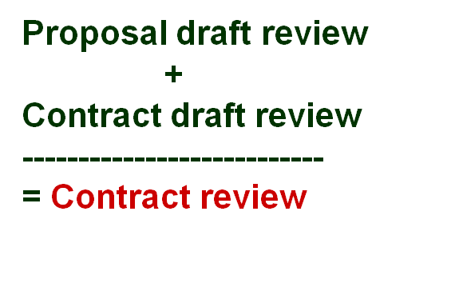
Stages of Contract Reviewing
Stage One – Review of the proposal draft prior to submission to the potential customer
Stage Two – Review of contract draft prior to signing

Slide 10
What to review?
Customer requirements clarified and documented
Alternative approaches for carrying out the project examined
Formal aspects of the relationship between the customer and the software firm specified
Development risks identified
Project resources and timetable adequately estimated
The firm’s capacity with respect to the project examined
The customer’s capacity to fulfill his commitments examined
Partner and subcontractor’s participation conditions defined
Protection of proprietary rights defined

Slide 11
Contract Attachments
Systems specifications
All responses and other materials completed from the Request for Proposal (RFP)
An Implementation Plan identifying the tasks to be completed, the assigned responsibilities and the scheduled completion dates

Slide 12
Disadvantages of unclear issues
Disadvantages to the customer
Implementation deviates from the needed applications Low satisfaction Unrealistic expectations about project feasibility Missing scheduled dates for beginning the distribution of new products Customer unprepared for project risks and their consequences

Slide 13
Disadvantages of unclear issues
Disadvantages to the developer
Higher change requirements Wasted resources due to introducing avoidable changes Substantial deviations from budget Friction between units Development activities are under time pressures and suffer from low quality Delays in freeing staff for their next project

Slide 14
Development plan and Quality plan

Slide 15
Objectives
Scheduling development activities and estimating the required manpower resources and budget.
Recruiting team members and allocating development resources
Providing management with data needed for project control.

Slide 16
Elements of Development Plan
Project products, specifying milestones and deliverables
Project interfaces
Development methodology and tools
Project staff organization and coordination with external participants
Development risks and risk management actions
Project cost estimates

Slide 17
Elements of Quality Plan
List of quality goals
Review activities
Software tests
Acceptance tests for software externally developed
Configuration management plans: tools, procedures and data for version releases

